Slide 1
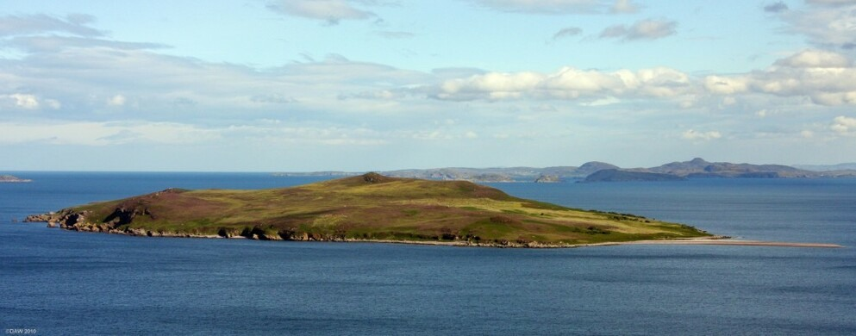
USING ISLANDS TO INCREASE SPEAKING PROFICIENCY
Betty Lou Leaver, Ph.D.

Slide 2
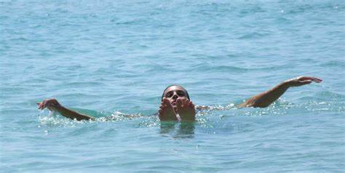
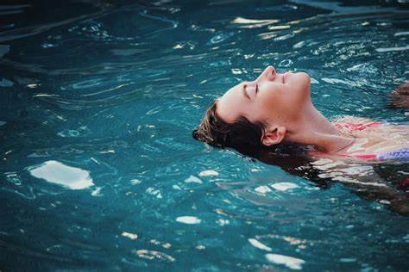
                The Concept
                Speaking is like swimming (constantly “stroking” for words)
                In long-distance swimming, an island is a place of rest
                Rest is when you can speak without thinking

Slide 3
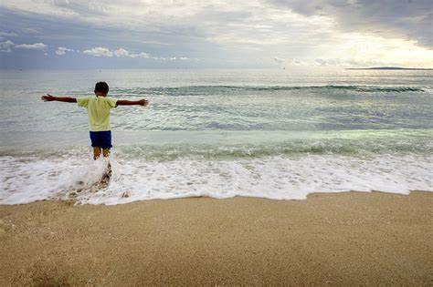
                The Concept -2-
                An island is a place where you can stop swimming until ready to start again
                It is a place where you can run about freely
                You feel safe; you know you are not in danger of drowning

Slide 4
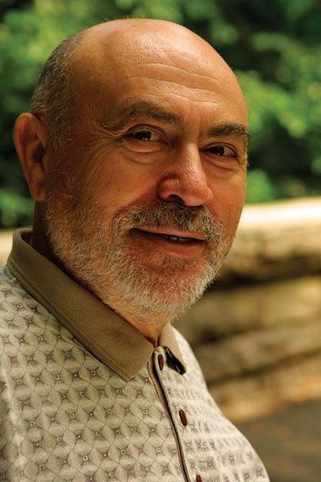
                The Concept Creator: Boris Shekhtman
                Una Cox Chapman Professor of Russian at Foreign Service Institute
                Director of Specialized Language Training Center (NYT, LA Times)
                Author of L2 methods books
“I do not teach a foreign language;
I teach how to use a foreign language in communication.”

Slide 5

                Islands as a Tool
                Islands as one of seven tools
                Most readily understood and acquired of the tools
                Immediate improvement in proficiency versus knowledge; performance versus competence

Slide 6
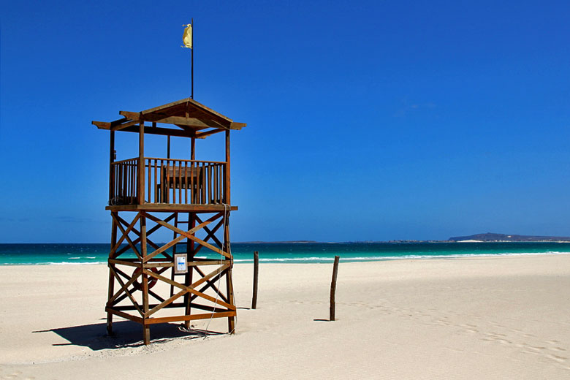
                What is an island?
                Concrete text
                Memorized through natural and pedagogical repetition
                Swappable parts
                Frequently used

Slide 7

                How does an island differ from a dialogue?
                Textbook-based dialogues are artificial & real-life interlocutors don’t know all the lines!
                Islands are monologues and even at lower levels of proficiency can be substantive.

Slide 8

                How does an island differ from “just talking”?
                Islands give the speaker near-complete control of the conversation.
                Islands are nearly always completely accurate* in lexicon, grammar, and, typically, content.
*MUST BE CHECKED AND REHEARSED WITH A NATIVE SPEAKER

Slide 9
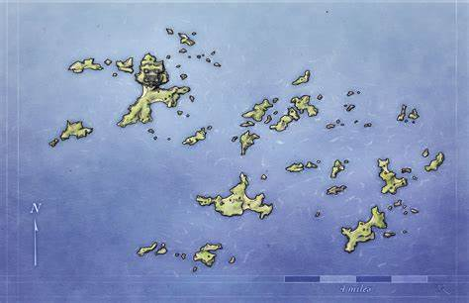
Islands and Proficiency Levels
Islands can be used at all proficiency levels.
At lower levels, islands will be short, on concrete topics, personalized topics and will be limited in scope and genre.
At the most advanced levels, islands can be long (chained to make a continent), complex, and on any kind of topic, including philosophical and sophisticated themes and will represent a range of genres (toasts, speeches, interviews, daily conversation).

Slide 10
Sample Topics for Islands
BEGINNING PROFICIENCY
Biography (personal)
Cooking & Shopping
Holiday preparations & activities
School/studies
Descriptions of relatives and friends
Favorite things
ADVANCED PROFICIENCY
Biography (professional)
Work responsibilities
History and significance of holidays
Studies & research
Discussion of nature and psychology of relationships
Politics, economics, etc.

Slide 11
Sample Islands
Biography for semi-formal self-introduction at a group gathering:
Hi everybody. My name is Susie Jones. I am so happy to be here tonight. Planning for a new after-school sports program for our children here at the Deerfield [School] is dear to my heart. I have two children who attend school here, and, as a child, I attended school here, too. This feels like home to me even though I spent ten years in Alaska working with fisheries there. I am so happy to be back here in the cornfields where I grew up with six brothers and sisters, picking corn in the summer and, ugh!, avoiding tornadoes in the winter. Perhaps we can name our new sports team the Tornadoes. (Just kdding – and just happy to be here tonight.)
(Replaceable parts: purpose, location, summer activity, winter reality/humor
(Templated parts: name, family, childhood, work, education, phraseology)
(Additive parts: more info about any of the templated parts)

Slide 12
Sample Adapted Island
Biography for formal self-introduction as a keynote speaker:
Good evening, everyone. My name is Dr. Susan Jones. I am very honored to have been invited to be your keynote speaker tonight. Planning after-school sports programs for young children is a topic dear to my heart. In addition to having raised two children of my own who were actively involved in sports while in school, I hold a master’s degree in sports education from Deerfield College, right down the street from this school and spent time working on a volunteer basis with three schools in Alaska when I was living there during a 10-year period. That said, let’s move on to the topic of tonight’s meeting: planning for a new and improved school sports program in Deerfield.

Slide 13
Communicative Value of Islands
ability to shift quickly into fluent speech
grammatical patterns for successful application to different contexts and situations e.g. Sports play an important role in my family = politics play an important role in our society
nearly intact use for similar situations, e.g., an island about Russo-American relations could be used for other political relations

Slide 14

Participant Interaction
Make a list of 4-5 topics that would be useful for you as islands.
Consider one topic each for (1) personal information, (2) daily interactions/functional-notional, (3) professional/work requirements), (4) hobbies & interests, and (5) conversations

Slide 15

How to Construct an Island – Phase I
Select your topic.
Find oral or written texts by native speakers on the topic; make sure you understand them.
Simplify them and adapt to you/your needs.

Slide 16
How to Construct an Island – Phase 2
Select/find a native speaker.
Have the native speaker correct your text/understand the corrections.
Rehearse alone and with the native speaker – then use in real life until firm.

Slide 17
Participant Interaction
List the steps you will follow to develop your #1 island. Consider with what native speakers you might be interacting, where you could get some rehearsal, and how you can get to accuracy for an island.
If you have time (and later), do the same for your other islands.

Slide 18
Your Islands – Phase 3
Increase the number of islands you have in the same genre/area.
Chain the same-topic islands.
Develop islands on other areas.
As proficiency increases, increase sophistication of your islands.

Slide 19
Some Tips
Remember the KISS principle: stick to what you know with limited new words and grammar.
If new lexicon is a must, keep the new “stuff” less than 10-20%; the more new, the greater the drag on memory.
With the “new,” strive for synonymy and redundancy.
Don’t try to talk about what you do not know.

Slide 20
Suggested Participant Interaction/My Offer
Think you already have an island, based on your language learning experience to date and things you always talk about? Take a few minutes now to write it down.
When done, share it with Tatiana for sending to me. I will make sure they are accurate and return them to Tatiana for returning to you.

Slide 21

Conclusion
Nothing in life is more important than the ability to communicate effectively.
- Gerald Ford
Notes:
DAR EL PREMIO!

Slide 22

References provided in handout and read-aheads

Slide 23
Using Islands to Increase Speaking Proficiency
Clarifications?
Reactions?
Feedback?
Needs?
Plans?

