Slide 1
American culture
American Culture

Slide 2
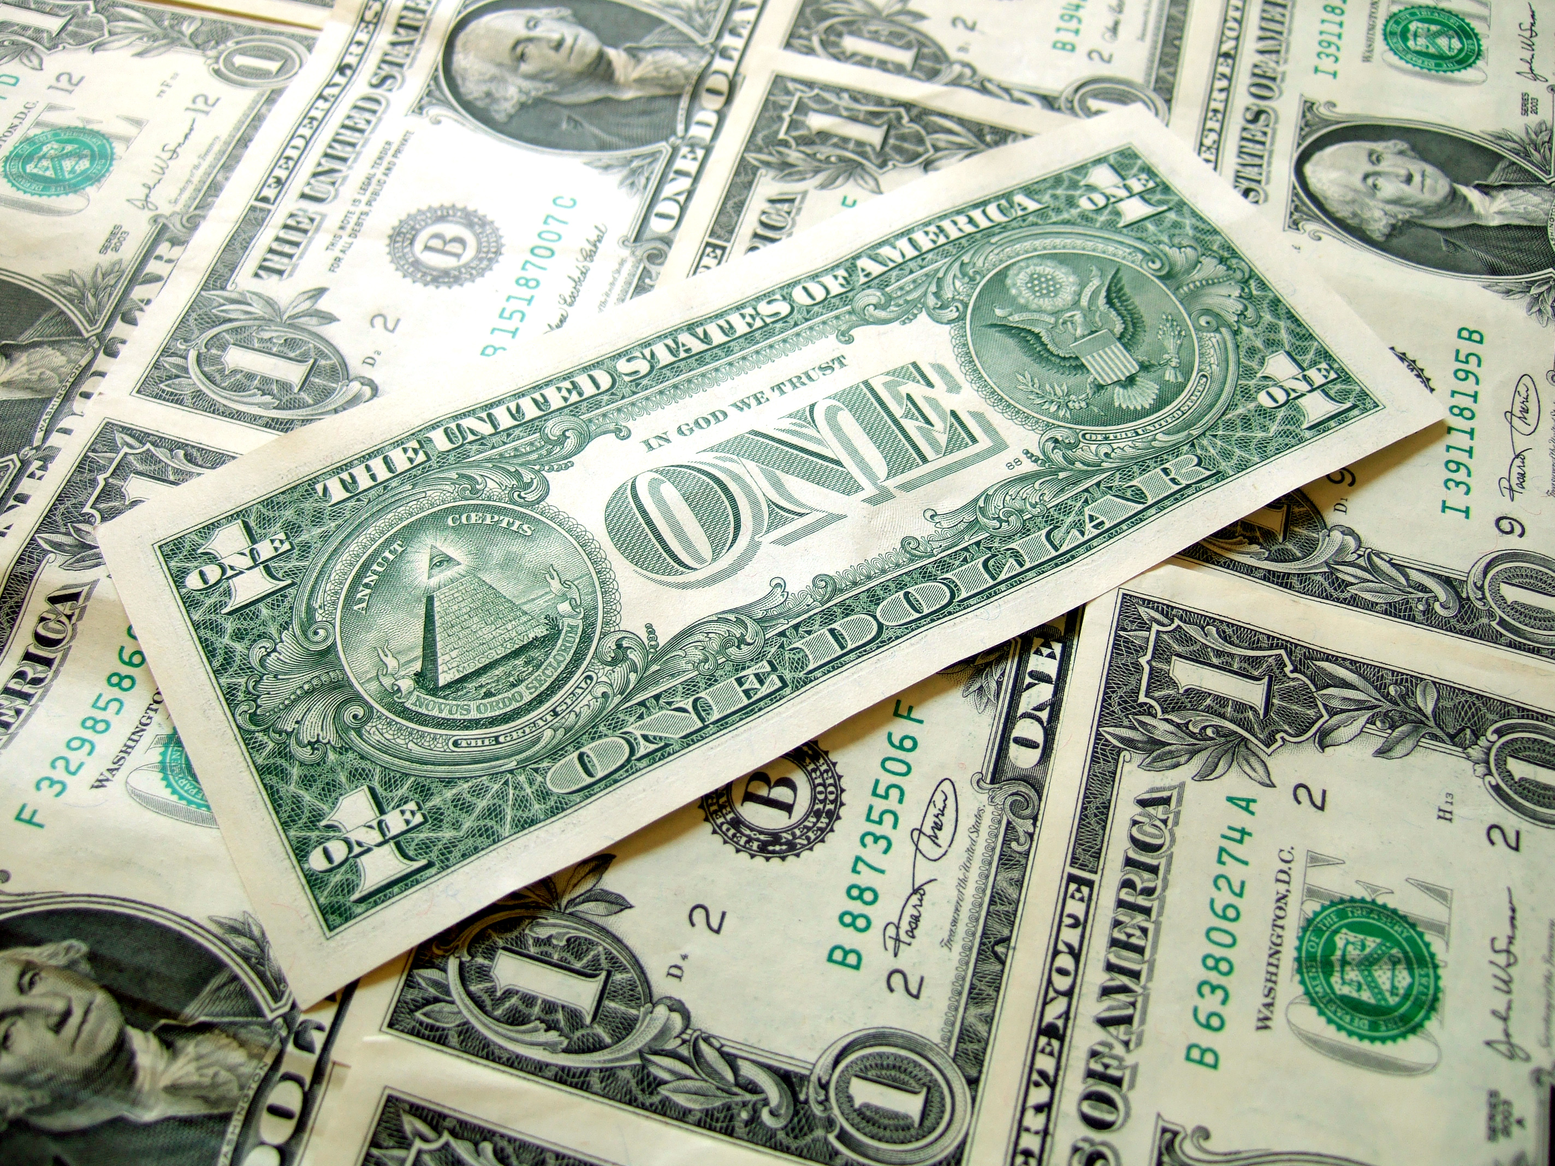
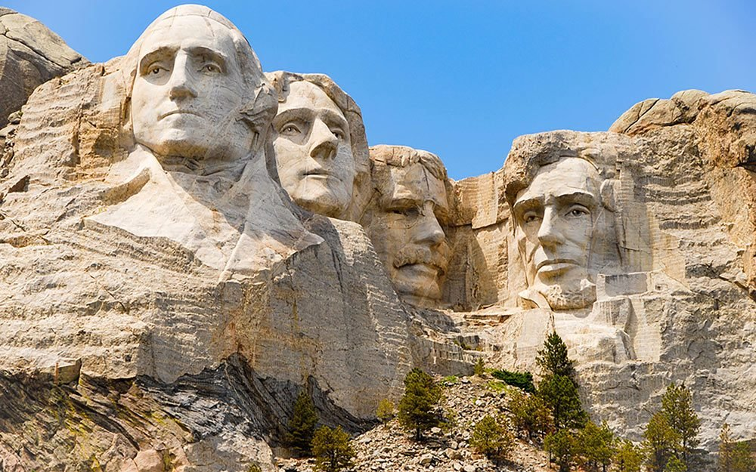
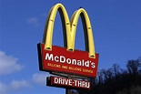
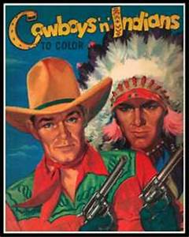
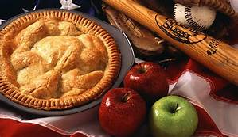
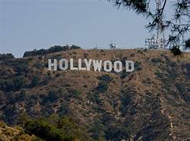
Cultural Icons

Slide 3
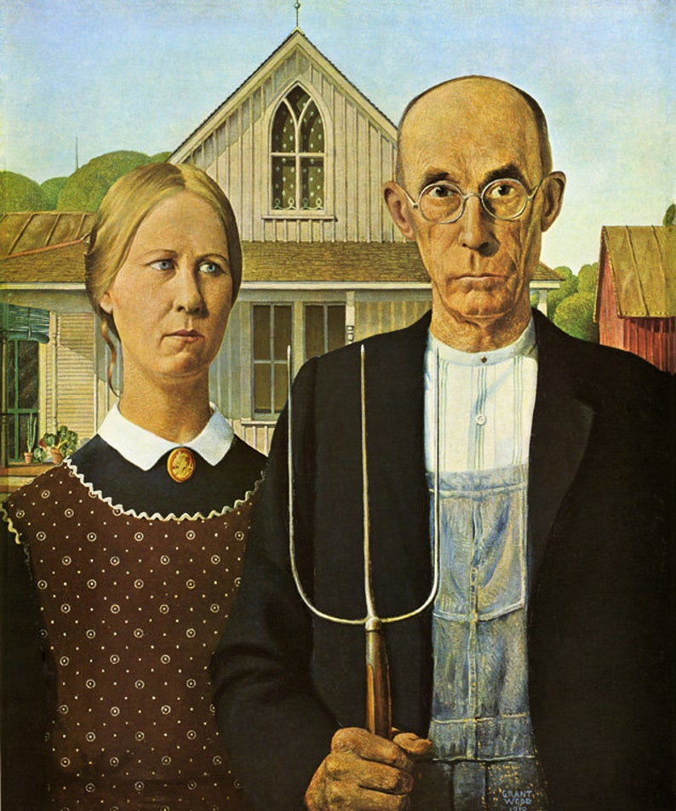
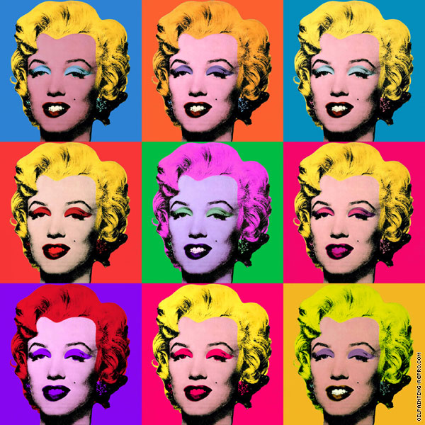
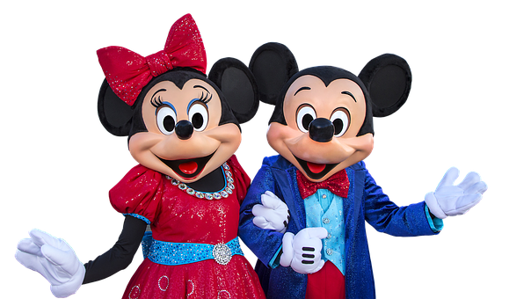
Pop Culture

Slide 4
FACTS AND STATISTICS
Area: 9.147,590 sq. km
Population: 328+ million (2019) A child is born every 8 seconds, a a person dies every 12 seconds, and a new immigrant moves to the United States every 33 seconds.
Race: White (72.4%), Black (12.6%) Native American (0.9%), Asian (4.8%)
Languages: No official language The Census Bureau estimates that more than 300 languages are spoken in the United States.
English – 230 million , Spanish – 37.58 million, Chinese – 2.88
million, French – 2.05 million, Tagalog – 1.59 million
Religion: Christian 65%, unaffiliated 26%, Jewish 2%, Muslim, Buddhist, and Hindu 1% each

Slide 5
Surprising info
One of only a few countries still using the imperial system of measurement (the others are Liberia, Bahamas, Palau, Cayman Islands, Marshall Islands, The Federated States of Micronesia)
The US is the ONLY advanced economy that does not federally mandate any paid vacation days or holidays. About one in four workers in the U.S. don't get any paid vacation time or holidays at all. American workers have to rely on their employers to set the minimum, (The average U.S. worker in the private sector receives 10 paid vacation days and six paid holidays).
There is no federal paid maternity leave (unlike 178 other countries) — it’s left to the states to figure out (only 3 have policies). Only 12 percent of women in the private sector have access to any sort of paid maternity leave, 40 percent of women don’t qualify for the Family Medical Leave Act (FMLA) which grants 12 weeks of unpaid protected job leave, 25 percent of women are forced to return to work within 2 weeks of giving birth to support their families.
Because of a loophole in labor laws, service employees like waiters and bartenders are legally allowed to be paid less than the mandated minimum wage. That means that they’re making as little as a few dollars an hour and depend on tips from customers to make up the difference in pay.
Americans spent nearly $100 billion on pets and pet care in 2020, a sum that has grown by about 4% to 5% a year since the great recession of 2008. That’s more than what they spend on smartphones or at the movies, combined, and greater than the GDP of Ethiopia.
Only in U.S., paper currency is the same color, size, shape and feel. (Canadian currency does not vary in size but has colors and tactile marks)

Slide 6
Values and Characteristics
The family unit is considered the nuclear family and is typically small. Extended family live in their own homes, often at great distances from their children.
Individualism is prized, and people are proud of their individual accomplishments and thrive on competition.
America, theoretically, is not a class-based society. The American Dream is based on the premise that anyone, from any background can achieve anything.
Genders are equal within American society and law. (However, women do not receive the same social and economic status or benefits as men, 2019 pay ratio 82%)
American greetings are generally quite informal and casual. Family, friends and colleagues use first names. Simple direct talk is valued; talk about the weather and sports but do not discuss income/costs of items, race, religion, politics or sex!
Americans do not tend to like close contact with others so keep your distance!
Time and punctuality are very important to Americans so don’t be late!
Many Americans love and follow sports; football, baseball and basketball are the most popular. Sports can be a huge uniting and dividing factor among Americans.
“The customer is always right” and everything can be returned!

Slide 7
Americanisms
https://www.youtube.com/watch?v=K1HxW5vc_lU&feature=youtu.be

Slide 8
FOOD/DIET
Americans eat large portions and a lot of processed and fast foods. As a result, their diet is high in fat, salt, sugars, preservatives and refined carbohydrates, and 60% percent of Americans are obese.
The utensils are switched between hands, using the fork with the right hand to eat then the knife is held in the right hand and the fork in the left hand while cutting.
Because Americans are regularly on the move, there is often not enough time to have a formal, sit-down meals, 20% of all American meals are eaten in the car. It is common for Americans to eat out several times a week and get take-out for lunch or go out to lunch everyday.
Foods commonly identified as American: hamburgers, hot dogs, potato chips, macaroni and cheese, and meat loaf. "As American as apple pie" has come to mean something that is authentically American.

Slide 9
Music and Dance
American musicians like Elvis Presley, Frank Sinatra and Michael Jackson are some of the most popular globally.
Jazz is one of the musical styles from the US to gain global acclaim. Jazz traces its roots to New Orleans. Blues music originally developed in the south but most well known in Chicago
Isadora Duncan was one of the pioneers of the American modern dance movement. Harlem, New York was the birthplace of lindy hop, a form of swing dance. Hip-hop and other street dance styles also originated in New York City.

Slide 10
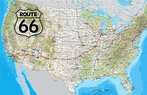
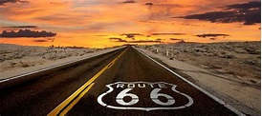
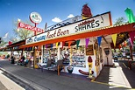
Traveling
Americans are, on the whole, very friendly people and happy to help when asked but outside of a few big cities, most Americans will only speak English
Public transportation is poor outside of major metro areas in the U.S.—and even then, the service, reliability, and ease of use can be frustrating. New York City, Chicago, and Boston have some of the country’s most robust public transportation systems
Cities on the east coast are easily accessible by train, but many Americans choose to fly because of convenience and price
More than 88% of Americans own a car, and many regions are only navigable by private vehicle
U.S. Route 66 (3940 km), also known as the Will Rogers Highway, the Main Street of America or the Mother Road, was one of the original highways in the U.S. Highway System, established on November 11, 1926, runs from Chicago, IL to San Monica, CA
.

Slide 11
U.S. Destinations to visit
https://www.youtube.com/watch?v=0PKDmDkKS2g

